Slide 1

TASK TWO THIRSTAID
SBL/3979

Slide 2

CURRENT RESOURCES EVALUATION AND COMPETENCE
A resource is a stock or supply of money, materials, staff, and other assets that can be drawn on by a person or organization in order to function effectively
Competence is the ability to do something successfully or efficiently
This Photo by Unknown Author is licensed under CC BY-SA

Slide 3

RESOURCES
Human resources | Technological | Good will resource | Infrastructure | Economic empowerment resource | Financial resources | Planning resources
SUCCESS

Slide 4
HUMAN RESOURCE
ThirstAid has a well laid down division of roles and responsibilities.
JESS CHAIR
TRUSTEES
JAMALCEO
MIA
OLIVER
SOPHIE
JONAH
AMIR
Notes:
The structure of ThirstAid from the chair is well laid down with;
The chair Jess who chairs the board of trustees , her competence is unquestionable having also served as the senior civil servant in foreign government.
The Trustees. The trustees ensures that Thirst Aid complies with the many regulations relating to charitable organizations and strategic advisors. ThirstAid has never at one point been stopped from carrying out their work due to violation of charity regulation act.
Jamal The CEO. He oversees the organizations strategic direction taken by the organization, he attends the board of trustee meeting, He appears in the media as the face of ThristAid, He has been captured by the national newspaper on the Front page together with Duranian Ambassador after a successful Drought fight .
Mia The head of Fundraising. He is responsible for running the fund raising team that aims at persuading individuals and organization to donate fund. ThirstAid has never experienced shortage of funds.
Oliver the head of operations he oversees volunteer team and plans and manages each aid project .He is multilingual which helps him communicate with volunteers of different nationalities who have helped in the past if opportunity arises.
Sophie is the political advisor and chief negotiator , she reassure governments them , answers their many questions and persuade them to allow ThirstAid accesses to where aid is needed she also arranges all their travels including tickets and visas.
Jonah the financial expert who also oversees the Information technology systems , ensures that the funding and spending priorities is set and adhered to. done on priorities bases . There has been no financial misaapropriation at ThistAID.
Amir the office manager .He manages the head office. He deals with every aspect of office management, from administration to cleaning and security. Each time we recruit someone new, Amir somehow finds space for them. Amir also makes sure that our insurance covers all of the appropriate risks.

Slide 5
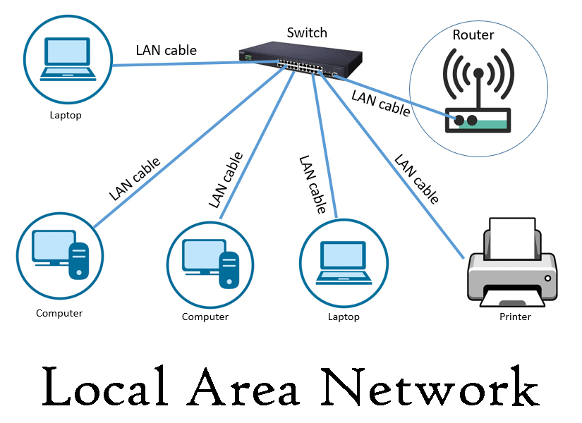
Technological Resources
The technological resource make use of ,
People
Information security ,
Machine
Time
Tools
Notes:
The people . The ThirstAid has a IT Jonah , personnel with basic level of it understanding. His competence is never doubted.
Tools and Information The office is installed with a local area network that has routers , the wifi password for the office network is displayed on the notices throughout the office. It has a central server that is used for data storage for data relating to volunteer, accounting and project.
Machines. ThirstAid staff use a mixture of desktop and laptop machines making their work effective.
Time an alarm system is fitted that is activated during the working hours making the operations effective.

Slide 6

Good Will Resource
Government willingness
Media coverage
Having volunteers
Trustees
Notes:
ThirstAid was contacted by the Duranian government due to prolonged drought ,thirst aid run hundred vehicles journeys where by at the end of project the Duranian ambassador to Norland visited head office to thank the ThirstAid. Following the visit a picture of Jamal and the ambassador appeared on the front page of ThirstAid local news paper and the story was picked by several national news programs.

Slide 7

Infrastructure Resource
Infrastructure include;
Transport
Communication network
Infrastructure include;
Transport
Communication network
D
Notes:
Oliver travels to manage project operations in different parts of the nations.
Oliver is multilingual which helps him communicate with volunteers of different nations.
During the Zara 2016 oliver with assistance of local fixers managed to borrow a plane, six daily flight return later roadlinks to the cut off villages had been restored and they were able to withdraw.

Slide 8


Economical Empowerment Resource
Notes:
It is a Thirstaid policy that no individual member of staff including the senior management earns more than a salary that equate to a multiple of 5 times the national living wage.
Salaries paid to thirstaid employee are linked to skills and experience.

Slide 9

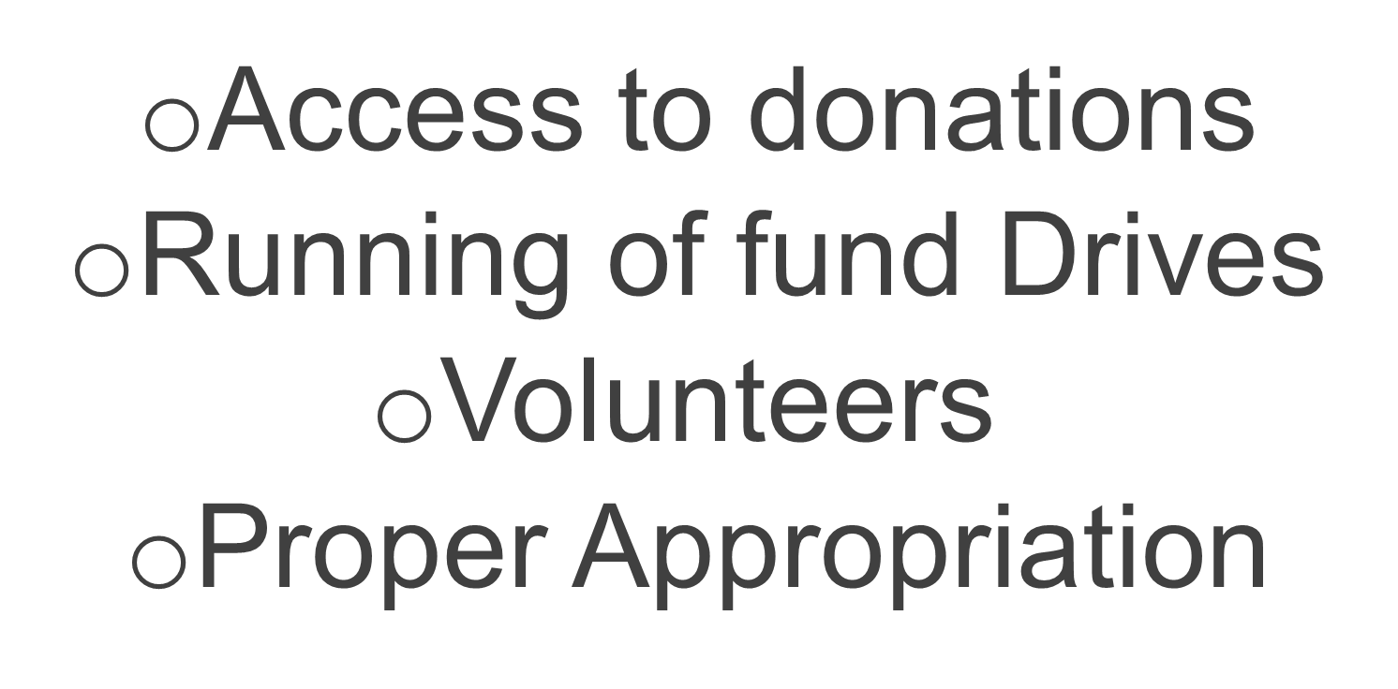
Financial Resource
Notes:
Jonah ThirstAid financial expert manages ThirstAid bank account and ensures Funds are available to pay bills as they fall due.
There have been a well appropriation of finances at thirstaid.

Slide 10
Planning and logistics Resources
The coordination of activities
Events Planning
Logistics Gathering
Notes:
The ThirstAid organization has a well laid down running and co-ordination of operations when providing water to communities in crises.
Failure to plan is planning to fail.ThirstAid ensures that there is proper planning and work coordination.

Slide 11



New Resources
Political good will
Database management
Technological advancement
Legal and insurance implications
Develop new procedures to cover medium term and long-term projects
Creating awareness

Slide 12

The volunteers
Proper Volunteer sensation
New Volunteers Registration
Proper storage of volunteer data
Volunteer Motivation
Notes:
There have to been a continuous camping to ensure a continued volunteers registration.
A volunteers website has to be one of the consideration. The website should have a form that ask the person to feed personal details into the ThirstAid website to ensure continuous recruitment.
Camping posters seeking to have new volunteers have to be displayed all over social media accounts to reach as many people as possible locally and worldwide.
This will ensure that there is easy of access of volunteers depending on where the disaster has occurred.

Slide 13

Training Professionals
.
Career development
Match current
Regulatory change
Purpose reminder
This Photo by Unknown Author is licensed under CC BY-SA
Notes:
ThirstAid must arrange training camps to its members and staff to ensure that they match their level of understanding and operating tools and machines effectively.
Ensure that all the precipitants of Thirst Aid adhere to the laid down regulation
Ensure no one goes a mess with the expected input/output.
Career is developed by making sure there is training after sometime. There is a remainder of the purpose of the mission and vision of the organization.

Slide 14

Political Good will
More Government willingness
Contribution to easy restrictions
Allow access to country sovereignty.
Partnership with the government
Notes:
ThirstAid should develop joint projects with the government as well as creating joint committees with the governments.
With Political goodwill thirstaid will enjoy less regulations and bureaucracy have more operational flexibility and excelsis and incentives for innovations.
The government will develop projects through injecting of funds in the economy thus making infrastructure such as roads to operate more effectively making the movement of the thirst aid organization first and efficient.

Slide 15
Database Management
Database design
Database content
Database accessibility
Database security
Notes:
There will be need to have a personnel who will be in charge of thirst aid Database.
Through expansion to other parts , thirstaid will need a robust and well laid database that will store the information's relating to the donors, volunteers, accounts in a secure and protected way .
This should ensure tight security against any threat to lose or hacking.
A server with sufficient storage will be installed for easy of data retrieval and storage as outgas are frequent.
The database security should be tightened to ensure data is not leaked to unauthorized personnel or lost.

Slide 16

Creating awareness
Awareness Tools
Posters, Brochures ,Magazines Pamphlets.
Website Designs
Functionality
Notes:
ThirstAid will bank on creating posters, brochures and pamphlets , websites and social media accounts.
This is to ensure that the gospel of thirstaid has reached to the willing volunteers, partners and donors , and also personnel's who would be in crisis.
Creating google ads will also be a reliable source to make sure that the ThristAID organization and activities have surfaced the world.
Creating awareness will provide thirstaid will a good will resource and a constant membership recruiting chance.

Slide 17

Technological Advancement
Well trained IT personnel
Up to date machine
Tightened security
Antivirus
Notes:
ThirstAid need to develop information technological systems.
This is to cope with new way of working staff on both medium term and long term projects. The staff and ThirstAid members will also need to consult experts for training as per the advancements.
Up to date machines will ensure that the available resource are utilized without outages.
Tight security to ensure physically no theft of machines and internally to ensure no data loss.

Slide 18

Develop new procedures to cover medium term and long-term projects
Developing yearly Procedures
Planning activities
Having an yearly calendar of events
Modern way of response
Notes:
ThirstAid should have a sustainability plan with specific long term and medium goals that assigns task to certain staff and ear marks budgets, to do so will move it in the right direction.
ThirstAid should consider having their own processing plant for bottled water, this will ensure that in the future their will be availability of bottled water.
The bottled water can be sold to parts that aren’t stricken by any calamities to get money to run their activities.
ThirstAid should accept partnership with other countries globally will help them develop their capacities thus making it sustainable in the long run.
ThirstAid should link with other donors, this network can be utilized to Borden the support of the partner organizations.

Slide 19

Legal and Insurance Implications
Insurance Policy
Implications of insurance
Insurance Expenditure
Notes:
The insurance policy is a contract that will be used to indemnify the organization for covered loses.
ThirstAid should be in a legal capacity to meet statutory and contractual requirements as well as provide evidence of financial resources.
ThirstAid should embrace insurance since it will reduce uncertainty of the society by ensuring its continuous operations to the communities in crisis.

Slide 20

Access money for infrastructure project
Access to money
Money appropriation
Expenditure projections
Notes:
Access more funds through grants from local state and federal governments.
This gives ThirstAid Organisation more credibility thus helping in securing more non profit funding from other sources.
ThirstAid should introduce membership fee from individuals and the partnership organization which will offer reliam=ble and recurring donations to their organization.

Slide 21

This Photo by Unknown Author is licensed under CC BY

